Slide 1
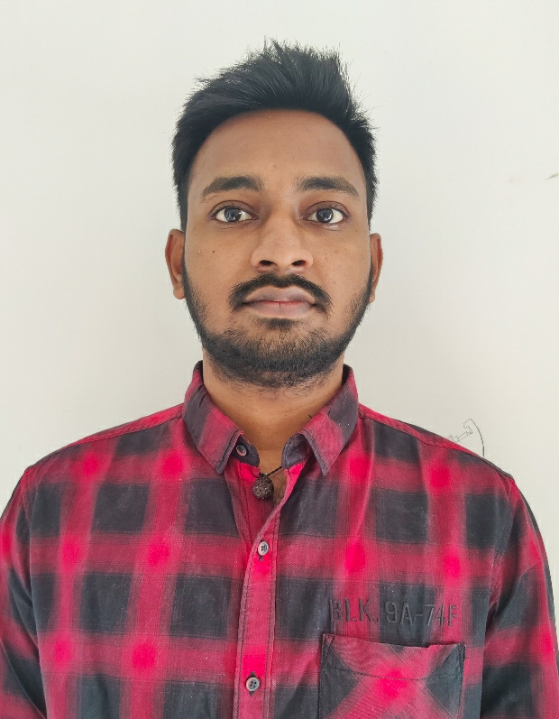

Rama Chandra Baddireedy
Analyst/Software Engineer
Vel Tech University ,B.Tech,
Computer Science & Engg: 2018-2022
Skills
C# | Basics, OOPS, Exception Handling ,Arrays ,Collection and Generics, Delegates and Events, File Io and Serialization.
.NET Framework | ADO.NET,ASP.NET with MVC5 and WEB API,Entity Framework
Ado.net | Basics Architecture
Database | SQL
Tools | GIT
UI Technology | HTML5 ,CSS & Angular
Add On Skills | Communication Skills, Team Management.
Mumbai
ramachandra8001@gmail.com
+91 6303222793
A4
.NET Core Full Stack Developer
Understanding of RDMS concepts using MS SQL Server.
Practical understanding of C# and SQL concepts using Visual Studio and SQL Server.
Hands on experience in developing applications using .NET Framework, ADO.NET Core, Asp.Net Core.
Understanding of HTML5 , CSS and Angular Cli.
Proficient in creating Single page Web Application in Angular with Authentication with routing.
Trained under iTransform.
Pharmacy Management System
Completed case study on Pharmacy Management System where we have created an Interactive website to create a bridge between Doctors and Pharmacy. A Doctor can be able to Register himself in the website and can view all the Drugs in the inventory and able to order required Drugs. Pharmacy Admin can Manage Suppliers, Drugs, Validate and Confirm Orders placed by Doctors.
Technologies used:
ANGULAR
ASP.NET CORE
Microsoft SQL Server
Video Link : Click
GitHub Link
https://github.com/sdsameer07

